Slide 1





Insurance
Analysis
______________________________________________________
An Interactive Business Intelligence & Data Analytics Project
Presented by : Sunaina Rajput

Slide 2
Problem Statement & Objectives
___________________________________________________________________________________________________
Problem Statement
Insurance data contains valuable information about customers, policies, premiums, claims, and policy status. Without structured analysis and clear visual reporting, identifying important trends, monitoring key performance indicators (KPIs), and understanding insurance portfolio performance can be challenging.
Project Objectives
• Analyze insurance portfolio data to understand overall performance.
• Calculate and evaluate key business KPIs using SQL.
• Develop interactive dashboards for data visualization and reporting.
• Identify patterns in policy status, claims, and customer demographics.
• Generate actionable insights to support data-driven decision-making.

Slide 3
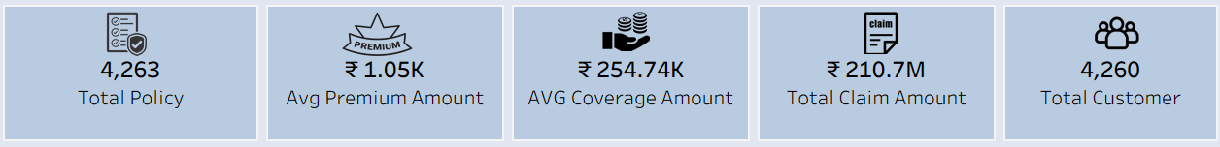
Dataset Overview & Key KPIs
__________________________________________________________________________________________________
Dataset Overview
Total policies/customers analysed: 5,000
Domain: Insurance
Data includes policy details, customer demographics, premium
amounts, claim amounts, and policy status.
Key KPIs

Slide 4
Tools & Methodology
___________________________________________________________________________________________________
Tools Used
• MySQL: Queried and analyzed insurance data using SQL to calculate key performance indicators (KPIs).
• Excel: Analyzed and summarized data and developed an interactive dashboard.
• Power BI: Created an interactive dashboard to monitor insurance KPIs and explore business trends.
• Tableau: Developed visualizations to analyze insurance data and identify patterns.
Project Methodology
• Data Understanding - Reviewed the dataset and identified relevant fields.
• Data Analysis - Used SQL and Excel to analyze the data and calculate KPIs.
• Dashboard Development - Created interactive dashboards using Excel, Power BI, and Tableau.
• Insight Generation - Analyzed visualizations to identify trends and support data-driven decisions.

Slide 5
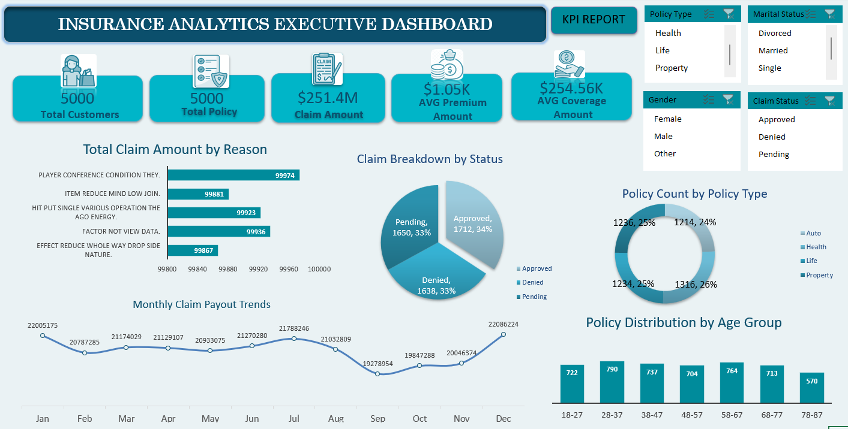
Excel Dashboard
Interactive dashboard for KPI monitoring and insurance data analysis.

Slide 6
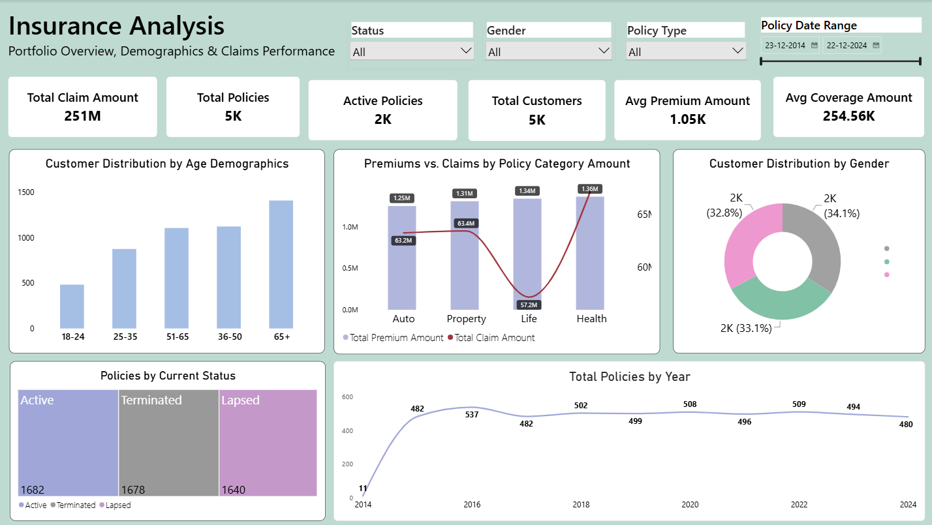
Power BI Dashboard
Executive dashboard for analyzing insurance KPIs, policy status, claims, and customer trends.

Slide 7
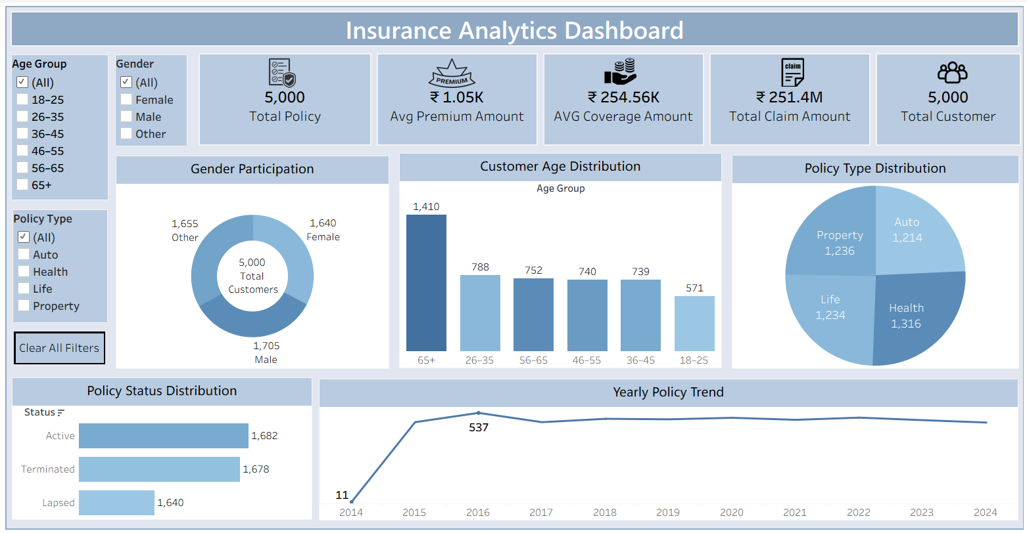
Tableau Dashboard
Interactive visualizations for exploring insurance data and identifying patterns.

Slide 8
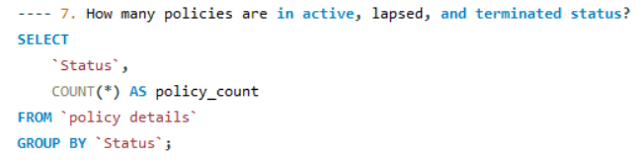
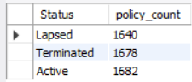
SQL Analysis & KPI Validation
_________________________________________________________________________________________________
Policy Status Analysis
This query analyzes the distribution of active, lapsed, and terminated policies to understand the current status of the insurance portfolio.

Slide 9
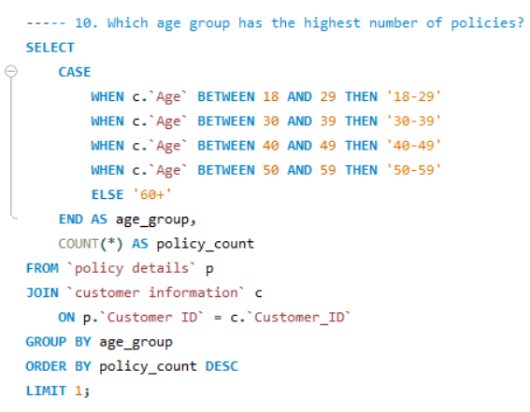

Customer Age Group Analysis
This query identifies the age group with the highest number of policies, helping understand customer demographics and policy participation.

Slide 10

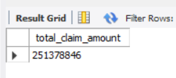
Total Claims Analysis
This query calculates the total claim amount across all policies to evaluate the overall claims volume within the insurance portfolio.

Slide 11
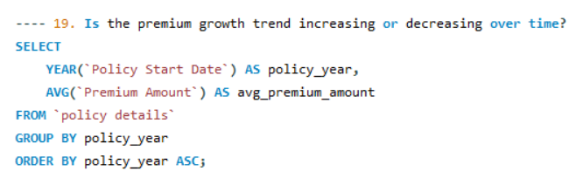
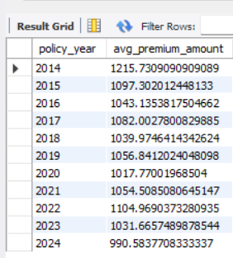
Premium Growth Trend Analysis
This query examines premium growth over time to identify whether the trend is increasing or decreasing.

Slide 12
Challenges Faced & Solutions
___________________________________________________________________________________________________
1. Data Understanding and KPI Identification
Challenge: Understanding the dataset and selecting relevant metrics for analysis.
Solution: Reviewed the available fields and identified KPIs related to policies, premiums, claims, and customer demographics.
2. SQL Query Development
Challenge: Writing queries to calculate the required KPIs accurately.
Solution: Used SQL functions, filtering, grouping, and aggregate calculations to obtain the required results.
3. Dashboard Design and Visualization
Challenge: Presenting multiple metrics clearly without making dashboards difficult to understand.
Solution: Organized KPIs, selected appropriate charts, and improved the layout and readability of dashboards.
4. Cross-Tool KPI Consistency
Challenge: Maintaining consistency in the KPI results across different analytical tools.
Solution: Compared corresponding results from SQL, Excel, Power BI, and Tableau and reviewed calculations when discrepancies appeared.

Slide 13
Key Insights & Findings
___________________________________________________________________________________________________
1. Policy Status Analysis
Out of 5,000 policies, 1,682 are active, representing 33.64% of the total. The remaining 3,318 policies are lapsed or terminated, highlighting an area for further retention analysis.
2. Claims Analysis by Insurance Type
Health Insurance recorded approximately $65 million in claims, while Life Insurance recorded approximately $57.2 million. This comparison highlights differences in claim exposure across insurance categories.
3. Customer Demographics
The 65+ age group represents the largest segment, with 1,410 policies. In comparison, the 18–24 age group accounts for 483 policies.
4. Policy Issuance Trend
Policy issuance peaked in 2016, with 537 policies. Annual issuance in other years remained around 480–500 policies.

Slide 14
Business Recommendations
_______________________________________________________________________________________________
1. Improve Policy Retention
Analyse the reasons behind lapsed and terminated policies and develop targeted retention strategies to improve policy renewals.
2. Monitor Claims Exposure
Regularly monitor claims by insurance type and investigate categories with higher claim amounts to support better risk assessment.
3. Strengthen Customer Segmentation
Use demographic insights to understand different customer groups and identify opportunities to reach underrepresented segments.
4. Automate KPI Monitoring
Use structured SQL queries and regularly refreshed dashboards to make KPI tracking more efficient and consistent.
5. Support Data-Driven Decisions
Encourage business teams to use the dashboard insights when reviewing policy performance, customer trends, and claims.

Slide 15
Conclusion
This project provided practical experience in analyzing insurance data using MySQL, Excel, Power BI, and Tableau. By calculating KPIs, validating results, and developing interactive dashboards, the project transformed raw data into meaningful visual insights.
The analysis helped identify patterns in policy status, claims, customer demographics, and policy issuance trends.
Key Learning Outcomes
Practical application of SQL queries and KPI calculations.
Development of interactive dashboards using three visualization tools.
Improved understanding of data analysis, visualization, and business insights.
______________________________________________________________________________________________________
Thank You!

